Slide 1

Depression Detection from Social Media Comments Using Deep Learning
Group No: 11
Group Members:
Syed Md. Ahnaf Hasan (ID: 23266008)
Md. Tanvir Hossain (ID: 24166030)

Slide 2
Table of Contents
Objectives
Literature Review
Dataset to be used
Tentative Methodology

Slide 3
Objectives
Training and testing various deep learning algorithms: RNN, LSTM, GRU and a pre-trained transformer model for the task of detecting depression from text in social media
Interpreting the predictions using the LIME XAI.

Slide 4
Literature Review
Ser | Paper title | Dataset Used | Techniques Used | Results and Findings
1 | Early Depression Detection from Social Network Using Deep Learning Techniques | CLEF eRisk 2017 dataset | Bidirectional LSTM with Word2Vec and GloVe word Embeddings | Using Word2Vec Embeddings with BiLSTM attained the highest F1 score (0.81).
2 | Naïve Bayes Classifier for depression detection using text data | CLEF 2020 dataset | Naïve Bayes, Logistic Regression, Random Forest and SVM | Naïve Bayes Classifier attains the highest accuracy (83%) of the models used.
3 | Evaluating text classification with explainable artificial intelligence | Collected from “SWOT’s Guide to KARACHI’s Restaurants Cafes Dhabas HBFE & Takeouts” | Naïve Bayes, Logistic Regression, Random Forest and SVM ML algorithms were used with LIME XAI | Random Forest model obtained the highest accuracy (95%) LIME explanations can improve faith in the model's predictions.
4 | Exploring the Impact of Word Embedding Dimensions on Depression Data Classification Using BiLSTM Model | Depression: Reddit Dataset (Cleaned) from kaggle. | GloVe and Word2Vec embeddings used with BiLSTM | Combined with BiLSTM Word2Vec outperformed GloVe with an accuracy of 96.22%
5 | Depression Classification From Tweets Using Small Deep Transfer Learning Language Models | Dataset was curated from Twitter and annotated using VADER and TextBlob | Electra Small Generator, Xtremedistill-16, Albert base V2, DistilBert | Electra Small Generator outperforms the other models with an F1 score of 89%.

Slide 5
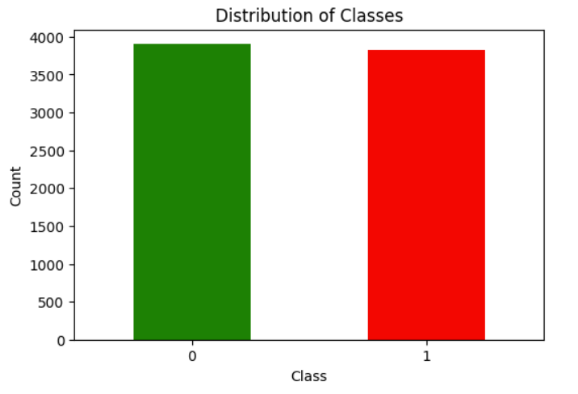
Dataset to Be Used
We will use the “Depression: Reddit Dataset (Cleaned)” used in the paper titled “Exploring the Impact of Word Embedding Dimensions on Depression Data Classification Using BiLSTM Model”. Link: https://www.kaggle.com/datasets/infamouscoder/depression-reddit-cleaned/code
The dataset contains 7731 labeled user comments with label ‘1’ indicating depression and ‘0’ indicating no depression.

Slide 6
Tentative Methodology
For the purpose of Classification we would like to use RNN, LSTM, GRU based models and fine tune a transformer model.
GloVe embeddings will be used to provide more contextual information to the words in the text.
LIME XAI to explain the predictions to be used.
Referred Code link: https://nzlul.medium.com/the-classification-of-text-messages-using-lstm-bi-lstm-and-gru-f79b207f90ad
Training/Fine Tuning Deep Learning Models
Interpreting Predictions using LIME XAI
Collect Dataset
Tokenization
Performance evaluation of the models

